Slide 1



VOIS Innovation
Marathon 2.0
On Emerging Technology

Slide 2
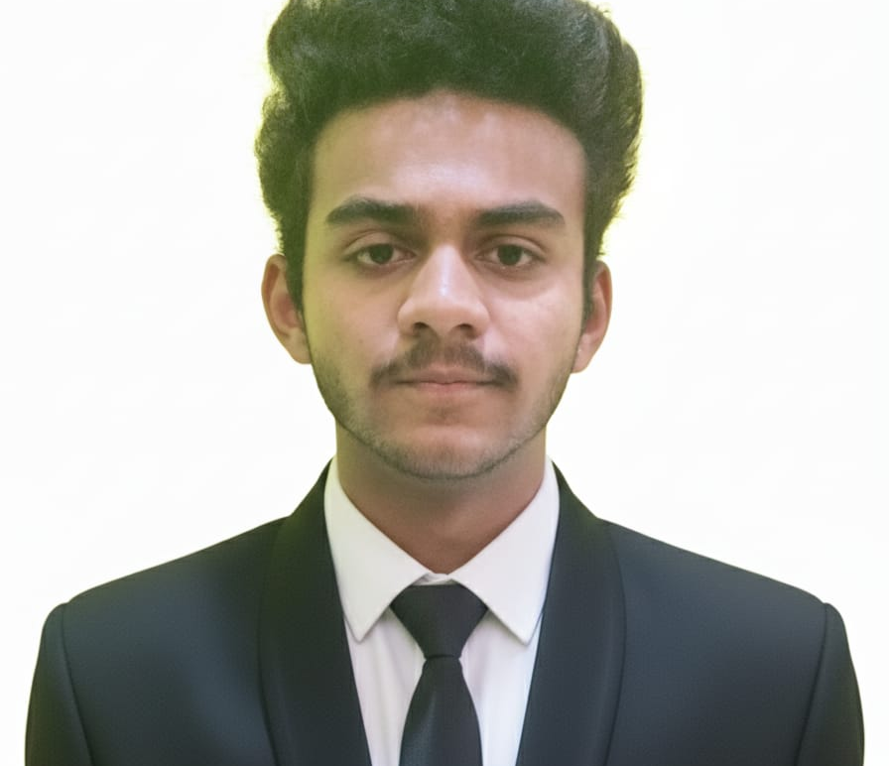

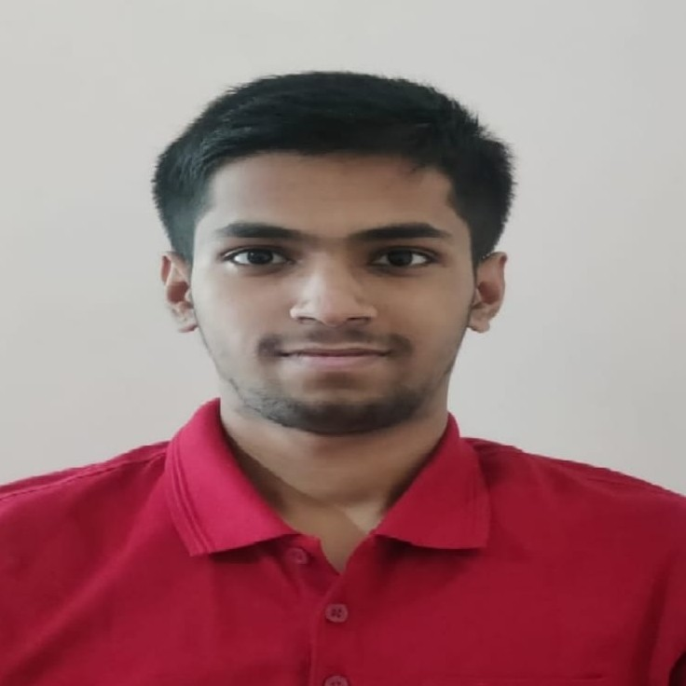
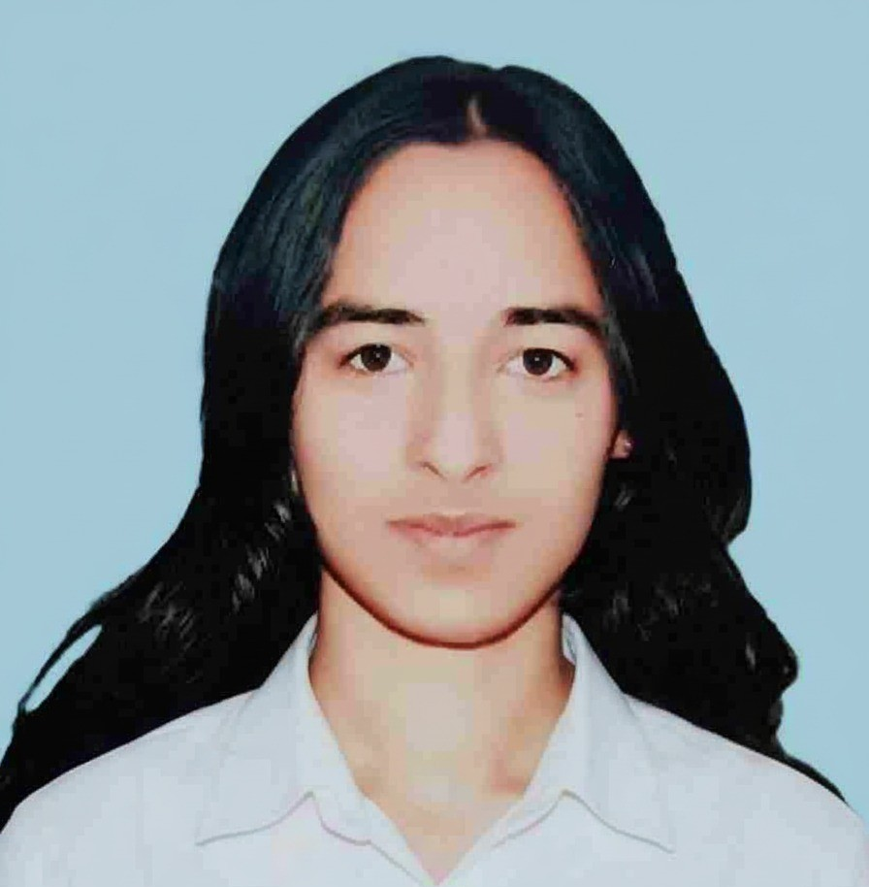

RouteSync One Ride Navigator
Insert your professional photo
Team No. 85 TECH MIRAGE
Team Lead, Soham Mule, AI&DS
Insert your professional photo
Insert your professional photo
Insert your professional photo
PVG COET & M Pune , Maharashtra
Aditya Tilekar, AI&DS
Komal, AI&DS

Slide 3
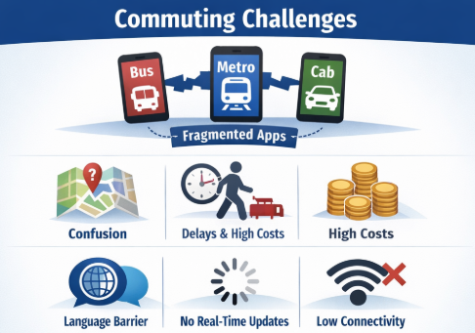
Problem Statement
Urban commuters often struggle with fragmented transport information spread across multiple apps resulting in confusion, inefficient planning, and increased travel costs. Challenges such as low internet connectivity and language barriers further limit accessibility.
Need of Project
Lack of a Unified Navigation Ecosystem
Absence of an Intelligent Multilingual AI Assistant
No Pan-India Integrated Transportation Network
Fragmented Real-Time Data Infrastructure
Proposed Solution
Single unified platform
Personalised Multilingual voice assistance
Data-Driven Cost–Benefit Analysis
Hyper-Personalized Safety Protocols
Family-Link Connectivity
ETA prediction

Slide 4













Solution Overview
Technology used
Unified Urban Mobility Platform
Seamless Multimodal Journey Planning
Predictive Intelligence & Advanced Analytics
Optimized First- and Last-Mile Connectivity
AI based Multilingual assistance
Scalable & Smart-City Aligned Architecture
Frontend & Backend - HTML, CSS, JS TypeScript NodeJS Python and ML Frameworks for Digital Twin simulation
Langflow Platform Langflow component name Search API, City Selection Agent, Local
Agentic AI
Gemini Model - 2.5, IBM grantie Model
Leaflet library of JS, Gemini API key, Uber Sandbox
AI based Multilingual assistance
Scalable & Smart-City Aligned Architecture

Slide 5
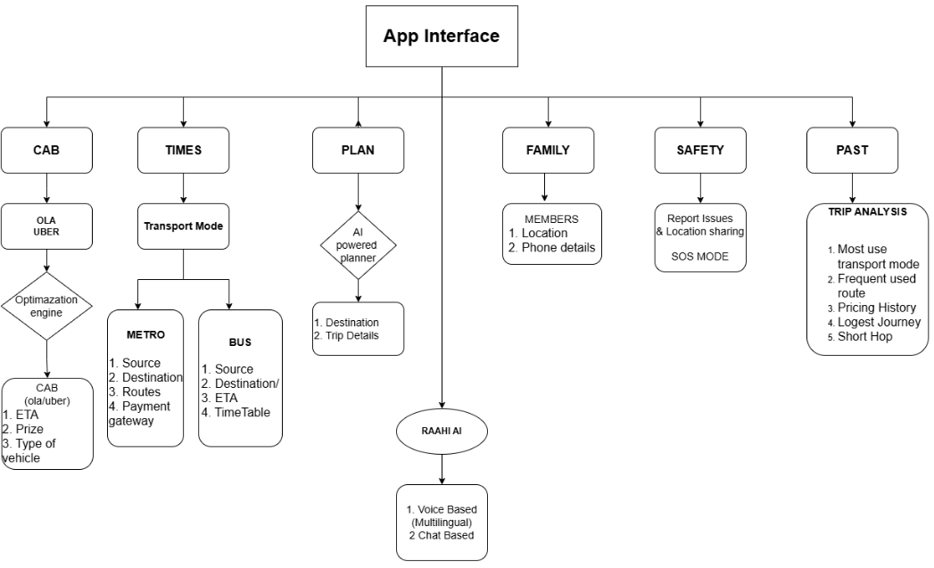
Technical flow diagram -

Slide 6
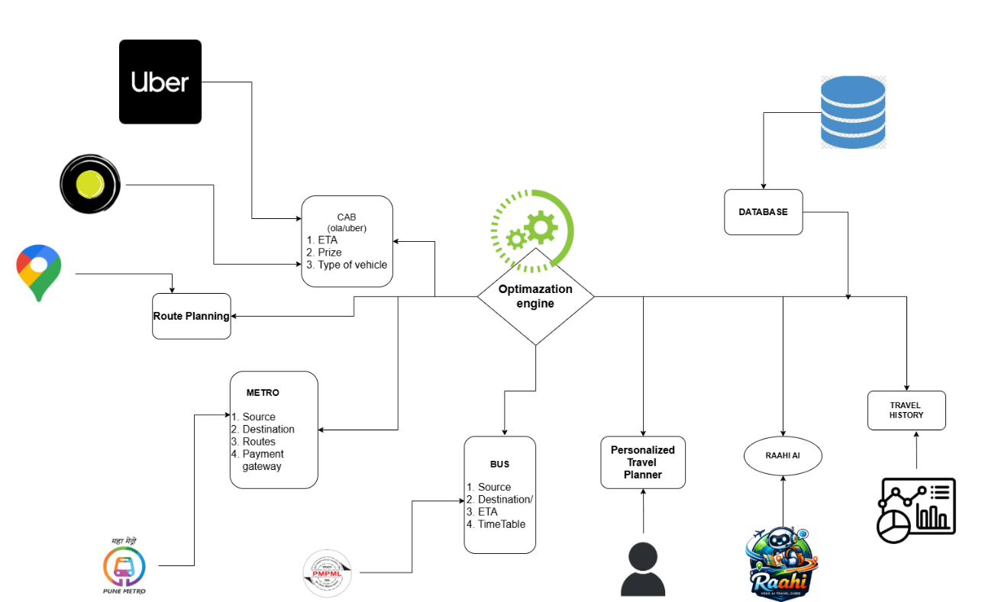
Architecture Blueprint

Slide 7
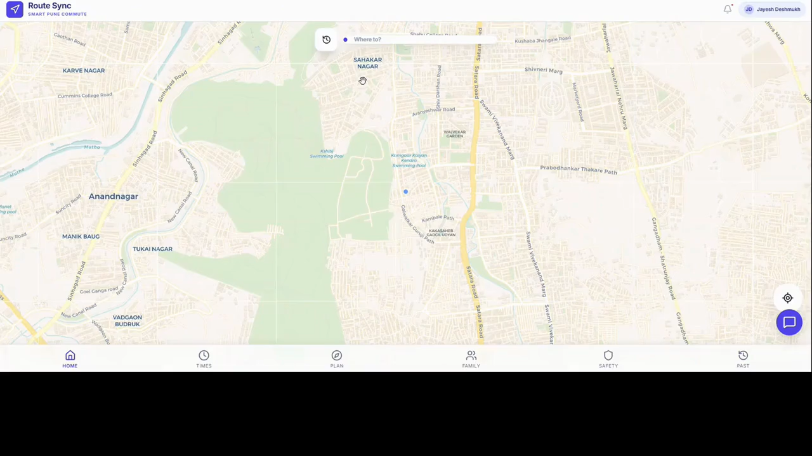
Demo video of RouteSync -

Slide 8
Novelty and Uniqueness
Unlike existing apps owned by transit providers (who favor their own fleets), RouteSync is Modal-Neutral. And RouteSync has Proprietary Multi-Modal Heuristic Engine which suggest best path across disconnected transit system
1
2
RAAHI AI: Multilingual Voice Orchestration: We introduce a voice-first, regional-language AI assistant that lowers the barrier to entry for diverse demographics, moving beyond traditional touch-interface limitations.
The "Single Pane of Glass" Experience: We eliminate "app fatigue" by aggregating fragmented data into one unified dashboard, reducing the cognitive load and decision-making time for daily commuters.
3
Granite‑guarded outputs ensure bias‑free, regulation‑compliant
advice.
Historical "Trip Analysis" Intelligence: Our system provides a deep-dive analysis of past behavior—tracking pricing history and "Short Hop" vs. "Longest Journey" patterns—to optimize future spending and route selection.
4

Slide 9
Future Scope & Github Link
Unified Mobility-as-a-Service (MaaS) Payment Integration
Implementing a single "RouteSync Wallet" - With one tap or unified QR systems to handle cross-provider settlements.
2. V2X (Vehicle-to-Everything) Connectivity
Integrating with Smart City IoT (Traffic lights, street sensors, and public Wi-Fi) to provide millisecond-accurate data.
3. Complete Implementation of Predictive "Digital Twin" Modeling
Using historical data for Urban Planning Insights.
4. Scaling RouteSync to all cities across India 5.
Proprietary Carbon-Footprint Calculation
Our intelligent optimization engine integrates real-time carbon emission analysis to recommend eco-efficient travel options, actively reducing carbon footprint and CO₂ emissions.
The working GitHub URL – Click Here

Slide 10
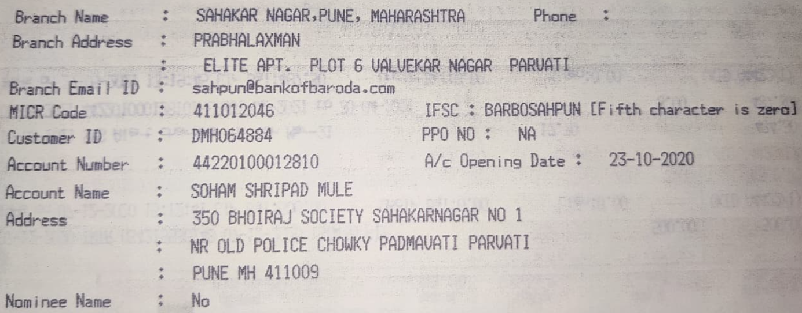
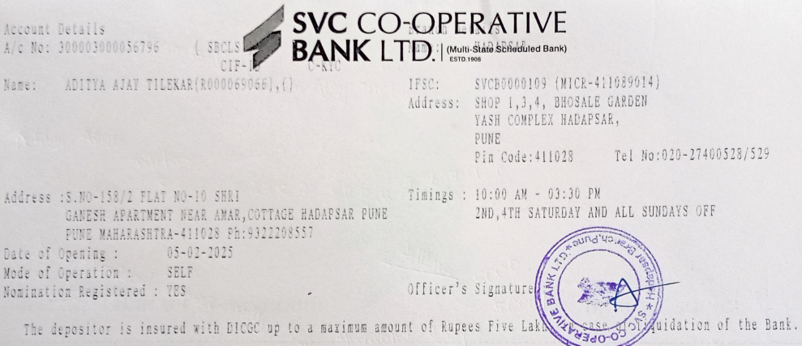
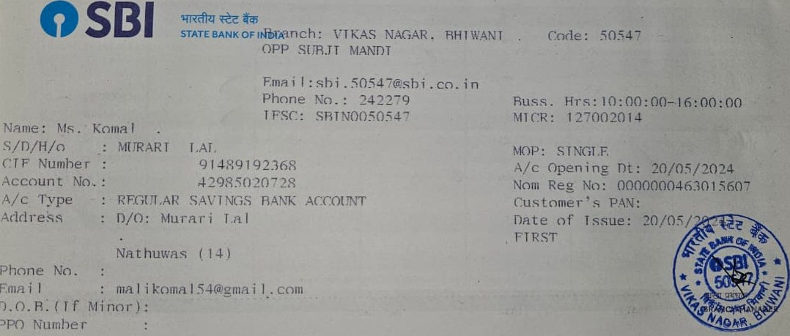
Bank Details
Full Name (as per bank records): | Bank Name | Branch Name | Account Number | Account Type (Savings / Current) | IFSC Code
Soham Shripad Mule | Bank of Baroda | Sahakar Nagar | 44220100012810 | Savings | BARB0SAHPUN
ADITYA AJAY TILEKAR | SVC Co-operative BANK LTD. | Hadapsar | 300003000056796 | Savings | SVCB0000109
Ms. Komal | SBI | Vikas Nagar,Bhiwani | 42985020728 | Savings | SBIN0050547
Insert photo of passbook / bank statement
Insert photo of passbook / bank statement
Team Member 1 Passbook/ Bank Statement With Name and Account Number
Team Member 2 Passbook/ Bank Statement With Name and Account Number
Team Member 3 Passbook/ Bank Statement With Name and Account Number

Slide 11
Thank You
-Team TECH-MIRAGE

